Slide 1



Creating Interactive Presentations using ‘Wooclap’

Slide 2

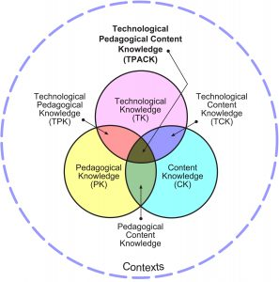
Technology & Beyond
Pedagogy
Technology
Techno-pedagogy
TPACK

Slide 3
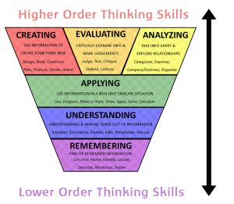

Further!

Slide 4
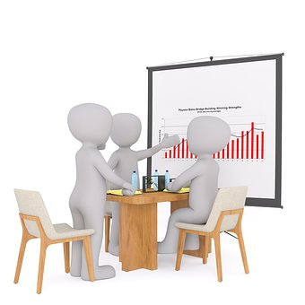
Presentations?!
To the point
Level of audience
Age appropriation
Multi-media integrated
Interactive and not passive

Slide 5

Wooclap
https://app.wooclap.com/

Slide 6

Wooclap
www.wooclap.com
Sign up
Create your Presentation
Present/Share

Slide 7

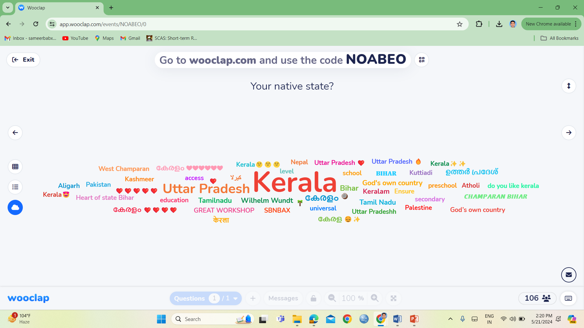
Wooclap

Slide 8
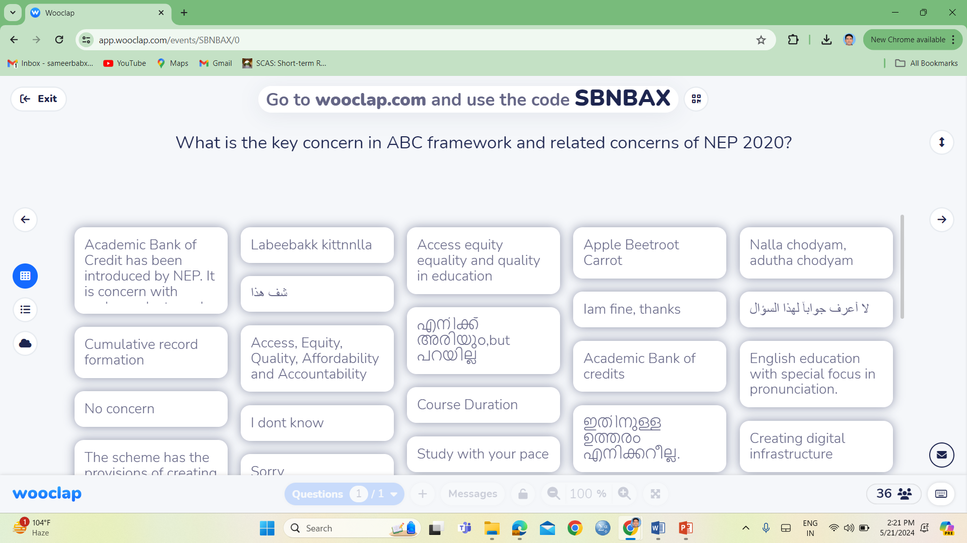
Wooclap

Slide 9
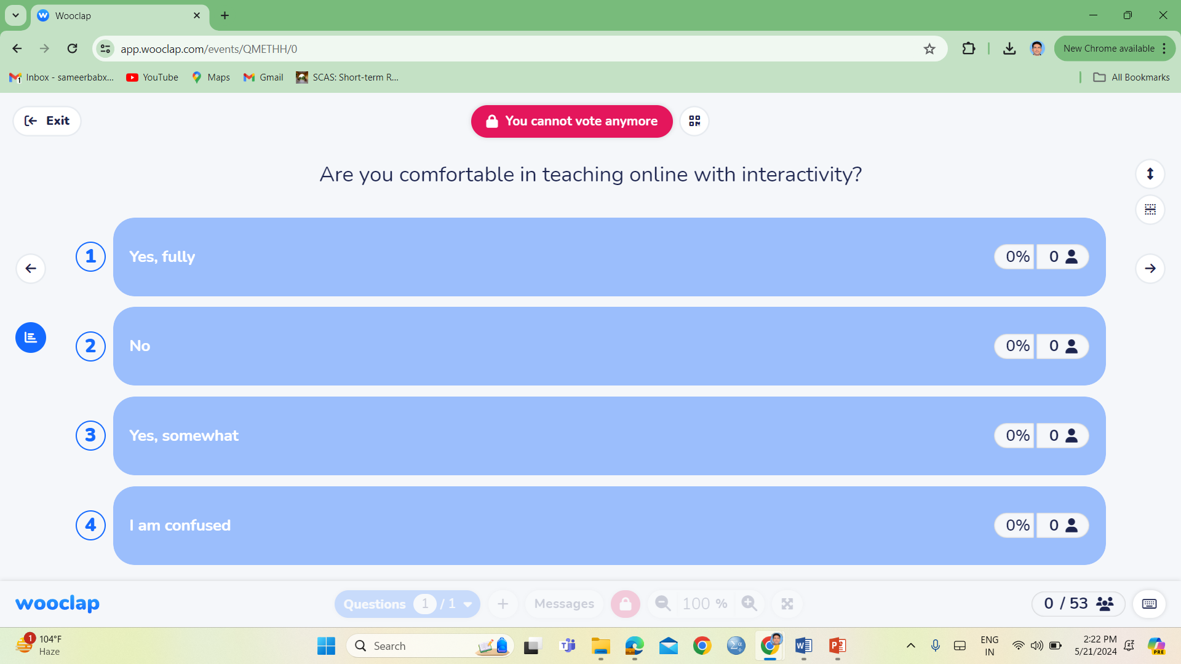
Wooclap

Slide 10
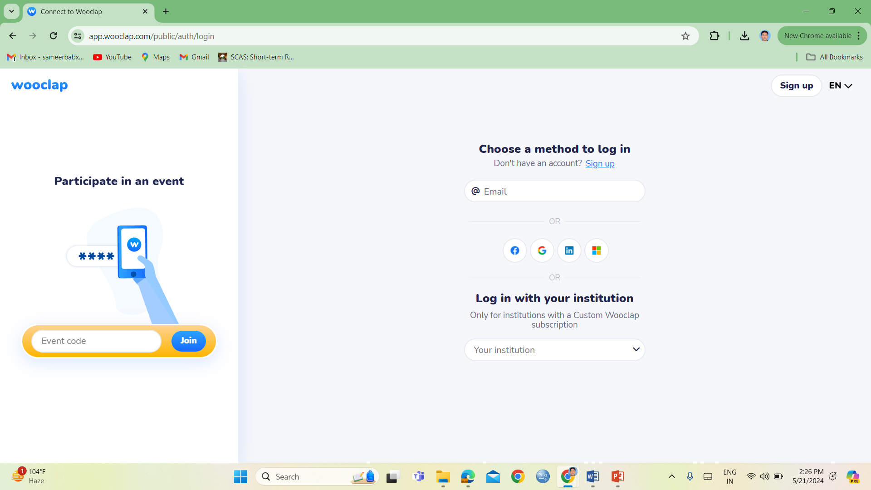
Wooclap-How?!
https://app.wooclap.com/

Slide 11

Wooclap-How?!
https://app.wooclap.com/
Sign-Up
Sign-In
Develop
Share
Display

Slide 12
Thank you for your time!
HAVE A NICE TIME!
Sameer Babu, Ph D
Associate Professor of Education
Jamia Millia Islamia
msameer@jmi.ac.in

